Slide 1
Introduction to Object-Oriented Programming

Slide 2
Introduction to OOP
Definition:
Object-Oriented Programming (OOP) is a programming paradigm based on the concept of "objects," which can contain data and methods.
Key Characteristics:
Emphasizes modularity and reusability.
Combines data and functions that operate on the data into a single unit called an object.
Historical Context:
Developed in the 1960s and 1970s as an extension of procedural programming.
Examples of OOP Languages:
C++, Java, Python, C#.

Slide 3
Benefits of OOP
Modularity: Code is organized into objects, making it easier to manage.
Reusability: Objects and classes can be reused across different programs.
Flexibility: OOP provides mechanisms like inheritance and polymorphism, which enhance code flexibility.
Maintainability: Easier to update and maintain code through encapsulation and abstraction.

Slide 4
Classes and Objects
A class is a blueprint for creating objects. It defines attributes and methods.
An object is an instance of a class. It contains the actual values and behaviors defined by the class.
Real-World Analogy: Class is a blueprint, and an object is a house built from that blueprint.

Slide 5
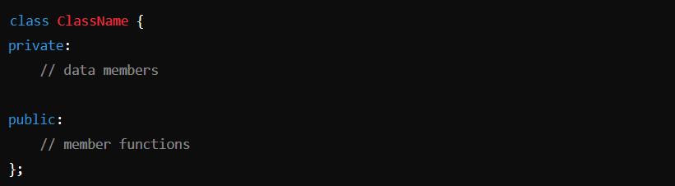
Defining Classes

Slide 6
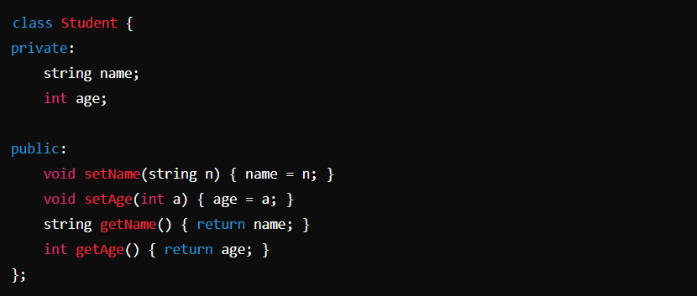
Defining Classes

Slide 7
Defining Objects

Slide 8
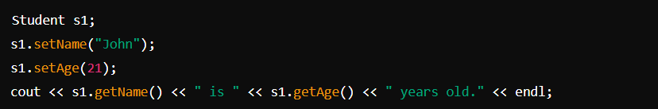
Creating Objects

Slide 9
Access Modifiers
Private: Members are accessible only within the class.
Public: Members are accessible from outside the class.
Protected: Members are accessible within the class and by derived classes.

Slide 10
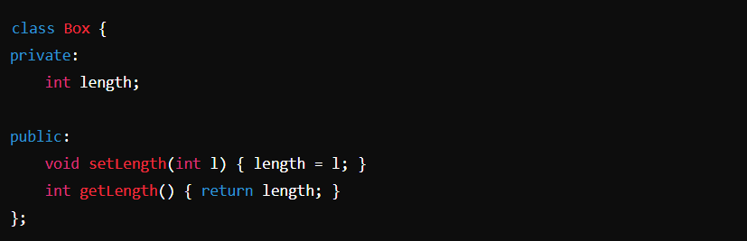
Access Modifiers

Slide 11
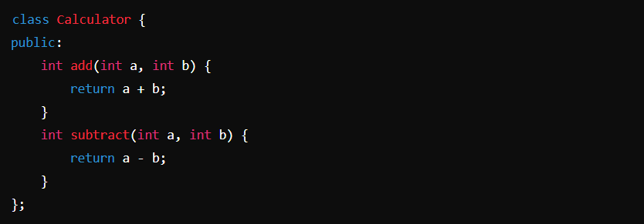
Member Functions

Slide 12
Constructors
A constructor is a special member function of a class that is automatically called when an object of the class is created.
Constructors are primarily used to initialize the data members of a class.
The name of the constructor is always the same as the class name, and it does not have a return type, not even void.

Slide 13
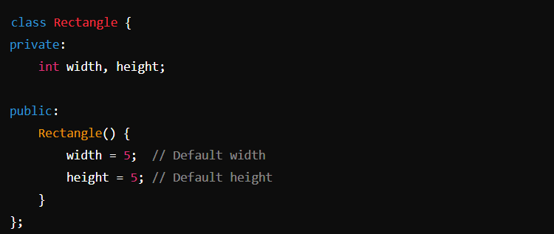
Default Constructors

Slide 14
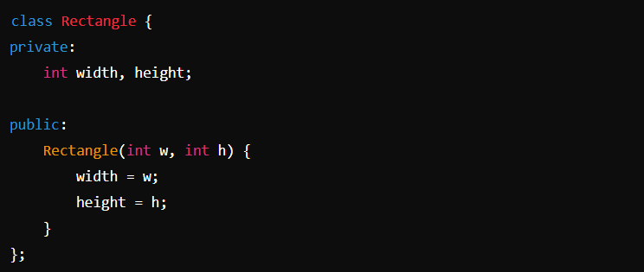
Parameterized Constructors

Slide 15
Destructors
A destructor is a special member function of a class that is automatically called when an object goes out of scope or is explicitly deleted.
The purpose of a destructor is to perform cleanup operations, such as releasing memory or closing file handles.
The name of the destructor is the same as the class name, preceded by a tilde (~), and it does not take any arguments or return any value.

Slide 16
Destructors
A destructor is called automatically in the following situations:
When an object goes out of scope (e.g., at the end of a block or function).
When the delete operator is used to destroy an object created with new.
When a program exits and global or static objects are destroyed.
Destructors play a crucial role in preventing memory leaks when objects manage dynamic memory.

Slide 17
Destructors
A destructor is called automatically in the following situations:
When an object goes out of scope (e.g., at the end of a block or function).
When the delete operator is used to destroy an object created with new.
When a program exits and global or static objects are destroyed.
Destructors play a crucial role in preventing memory leaks when objects manage dynamic memory.

Slide 18
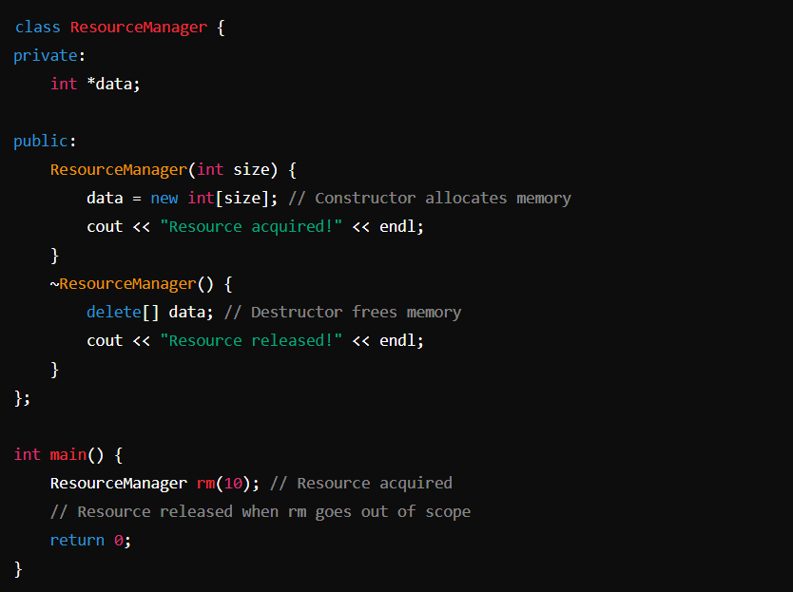
Constructors and Destructors Together

Slide 19
Fundamentals of OOP
Encapsulation
Abstraction
Inheritance
Polymorphism

Slide 20
Encapsulation
Encapsulation is the bundling of data (attributes) and methods (functions) that operate on the data into a single unit, known as a class.
Protects data from unauthorized access.
Simplifies code maintenance.

Slide 21
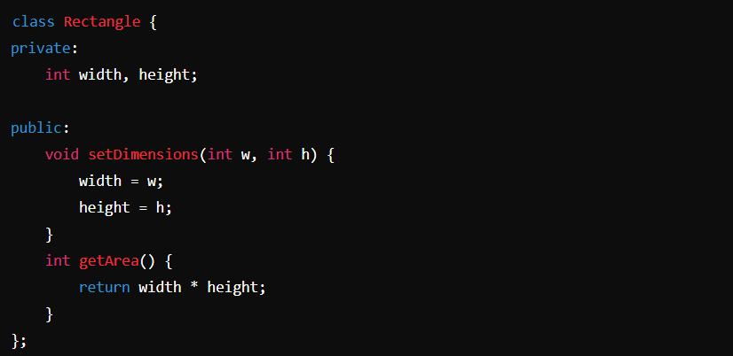
Encapsulation

Slide 22
Abstraction
Abstraction is the concept of hiding complex implementation details and showing only the essential features of an object.
Reduces complexity.
Focuses on what an object does instead of how it does it.

Slide 23
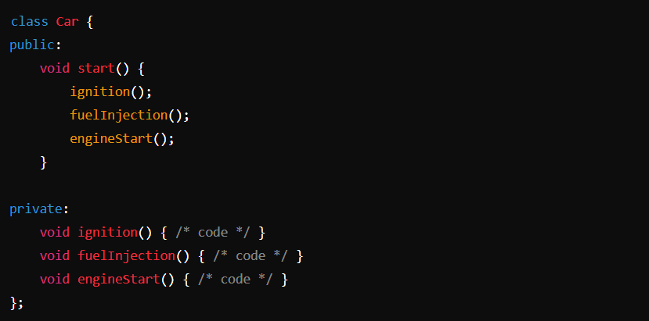
Abstraction

Slide 24
Inheritance
Inheritance is a mechanism by which one class can inherit properties and behaviors from another class.
Promotes code reusability.
Establishes a natural hierarchy between classes.

Slide 25
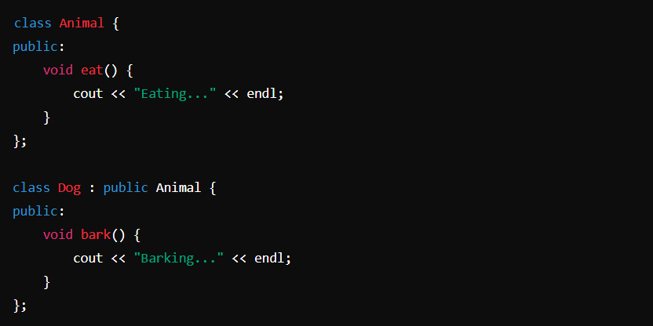
Inheritance

Slide 26
Polymorphism
Polymorphism allows objects of different classes to be treated as objects of a common base class. The most common use of polymorphism in C++ is through virtual functions.
Increases flexibility of the code.
Simplifies code management in large systems.

Slide 27
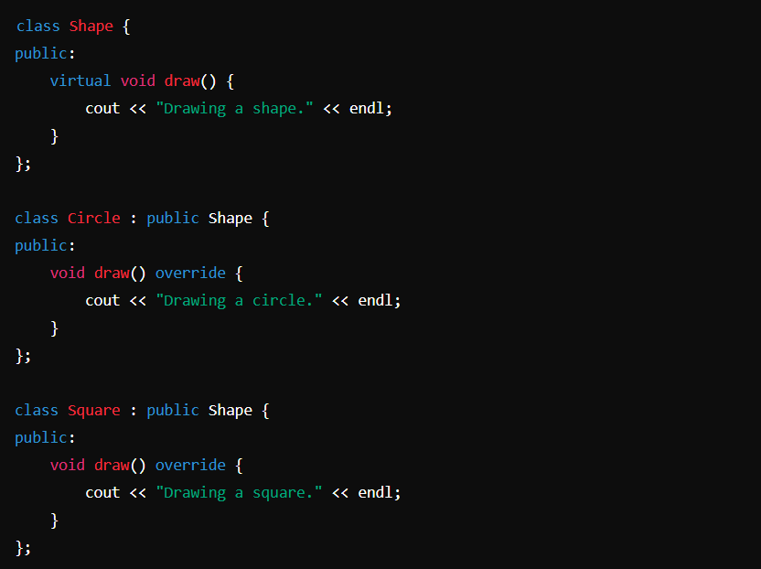
Polymorphism

Slide 28
Coding Exercise

